Slide 1

Grace Lane

Slide 2
Overview

Slide 3
What is it?
Sword and Shield (2019)
Brilliant Diamond and Shining Pearl (2021)
Scarlet and Violet (2022)
Pokedex
Pokémon
Poke balls
Sandwich recipes
Notes:
This database is for searching through Pokémon games. Specifically, Sword and Shield, Brilliant Diamond and Shining Pearl, and Scarlet and Violet. You will be able to search the games' Pokedex for Pokemon and also search for what Poke Balls are available in the games. In addition, you will be able to find established recipes for sandwiches found in a game.

Slide 4
Milestone 1
ER Diagram

Slide 5
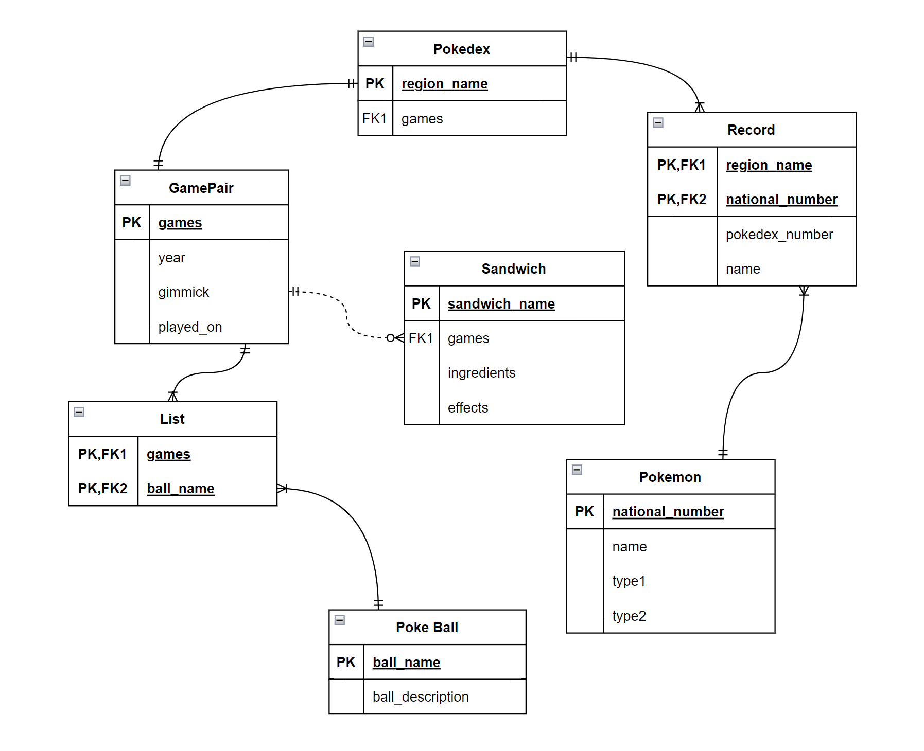
ER Diagram
Game Pair
Entities
Game Pair
Pokedex
Record
Pokémon
List
Poke Ball
Sandwich

Slide 6
Milestone 2
Normalization

Slide 7
Normalization
game_pair (games, year, gimmick, played_on)
pokedex (region_name, games)
pokemon (national_number, name, type1, type2)
record (region_name, national_number, pokedex_number, name)
pokeball (ball_name, ball_description)
list (year, ball_name, games
sandwich (sandwich_name, games, ingredients, effects)
1NF- no repeating groups, all data values are atomic, each field has a unique name, and it has a primary key.
2NF- in 1NF and all non primary key attributes are dependent on all parts of the primary key.
3NF- in 2NF and all non primary key attributes are not dependent on each other.

Slide 8
Milestone 3
SQL

Slide 9
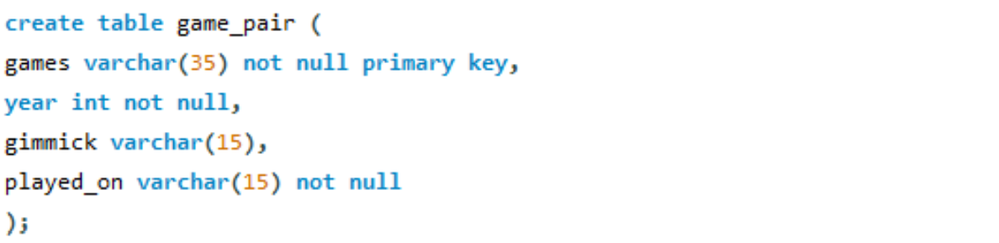
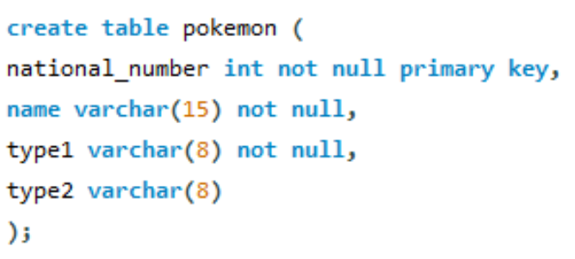
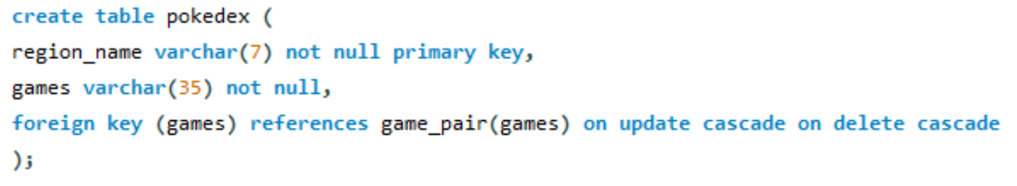
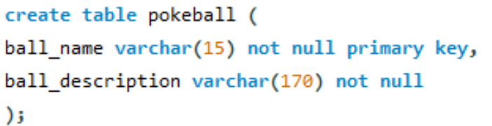
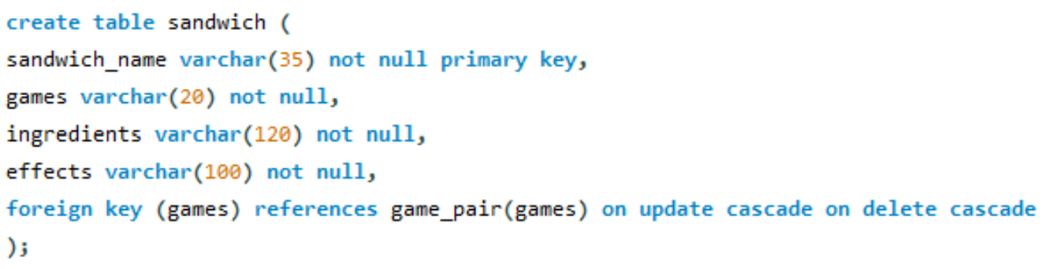
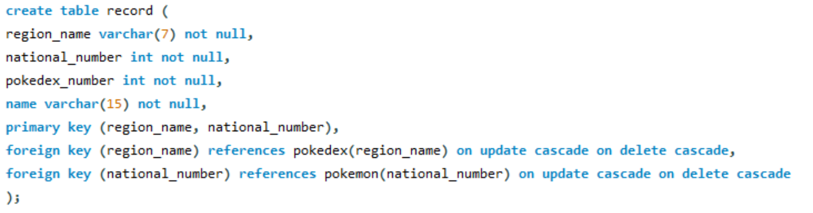
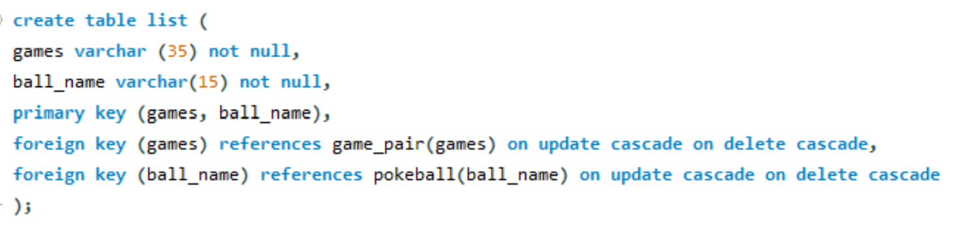
Entity Tables

Slide 10
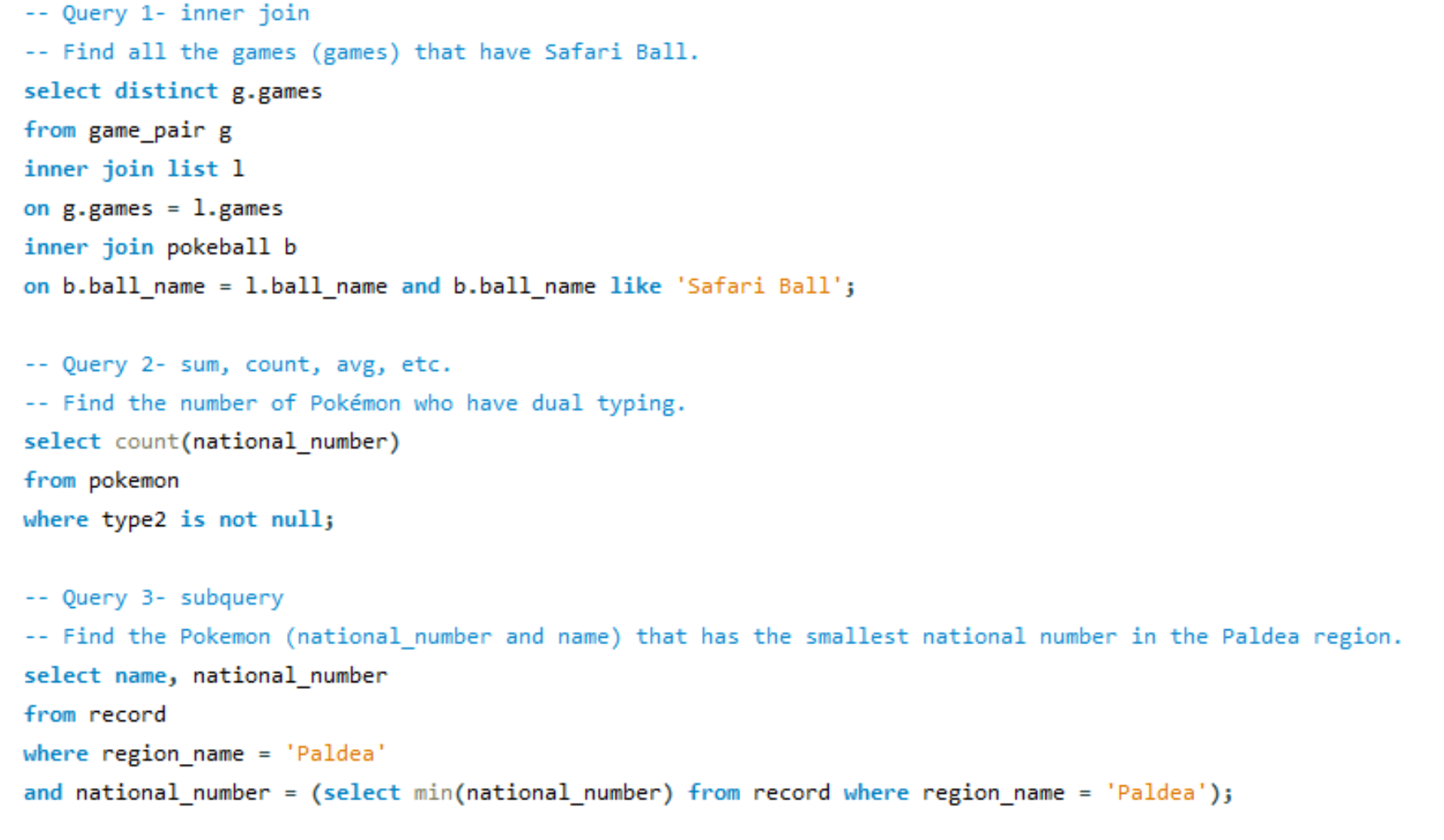
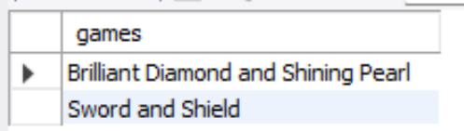
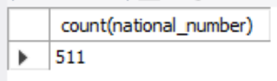
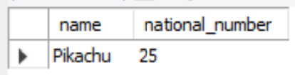
Queries

Slide 11
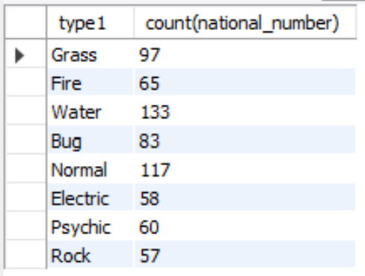
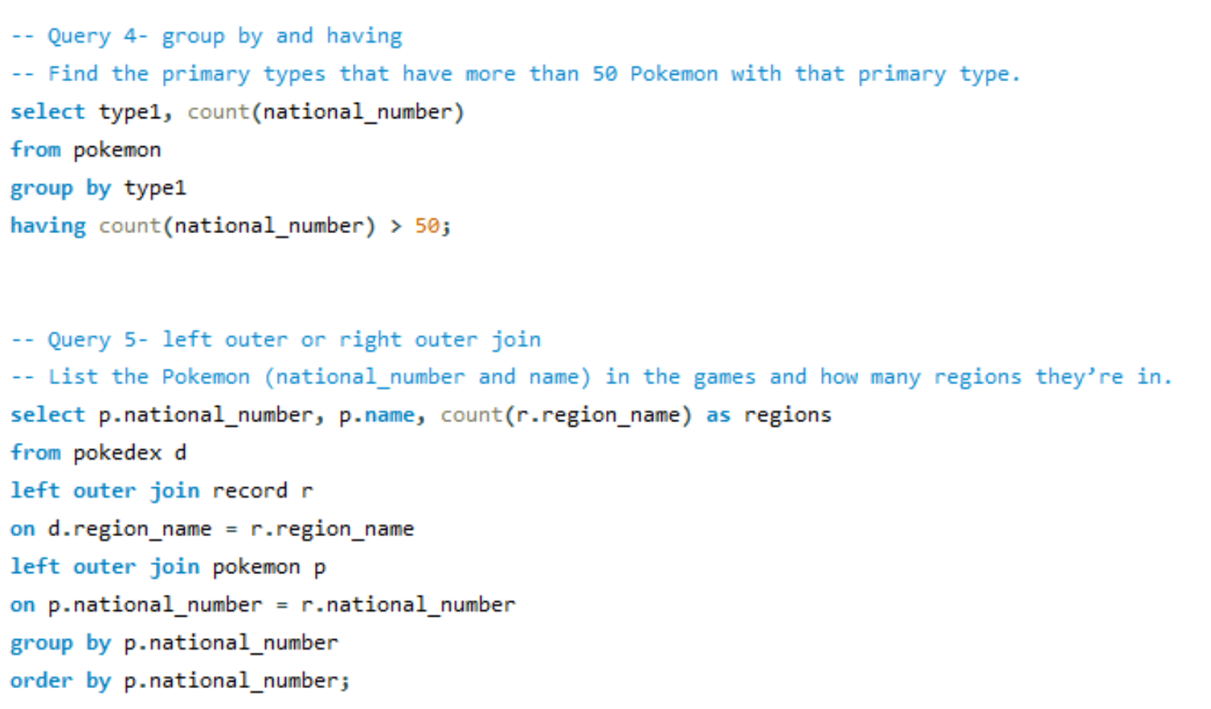
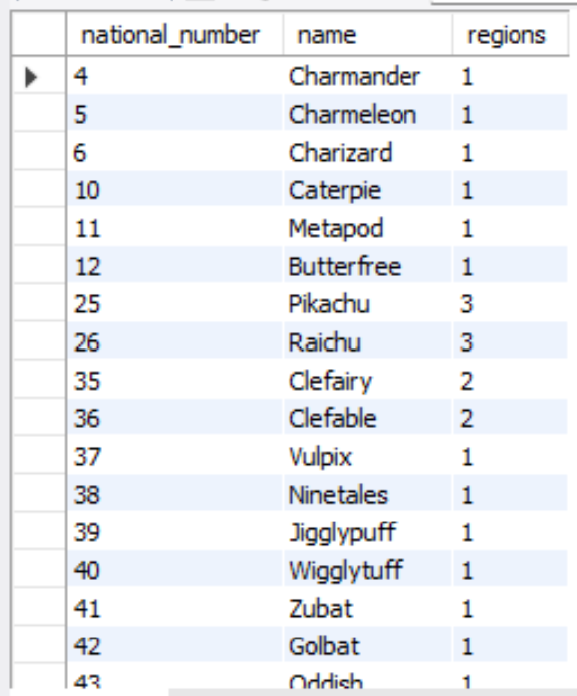
Queries

Slide 12
Milestone 4
Application

Slide 13
Techniques
ERD for organizing the entities and their relationships
SQL for storing all the entities and their data
HTML for basics of the website
CSS for styling
PHP for connecting to the database
Procreate for creating the logo and favicon

Slide 14
Problems/Difficulties
Styling
Trial and error
Learning new languages
CSS
PHP

Slide 15
Website Link
https://css1.seattleu.edu/~glane/website/homepage.html

